Slide 1
Introduction to Big Data
INFS 774 Big Data Analytics
Jun Liu
Dakota State University

Slide 2
What is Big Data？
Data that will not fit in main memory (maximum 512 GB for a windows server)
Can’t be analyzed using stats tools
Not just “Big” amounts of data

Slide 3
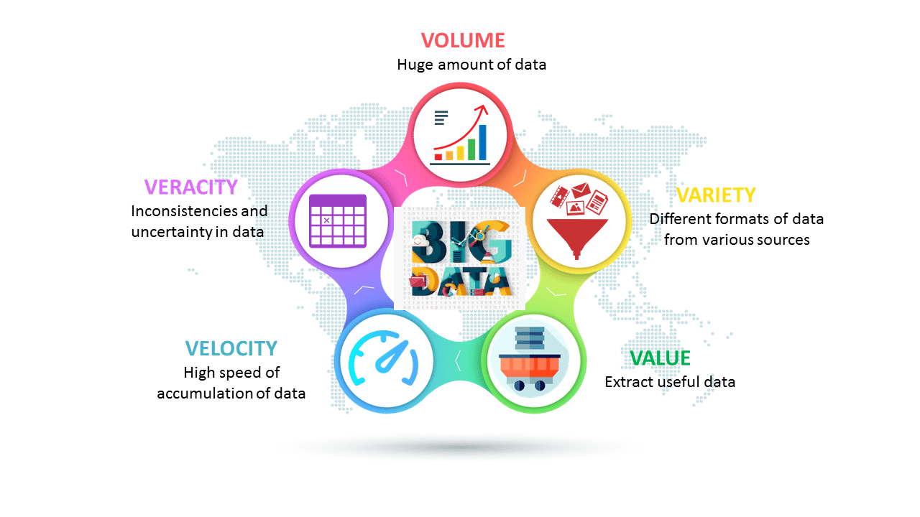
Big Data characteristics (IBM’s 5Vs)
Notes:
Structured vs unstructured.

Slide 4
Brief Overview of Big Data Systems

Slide 5
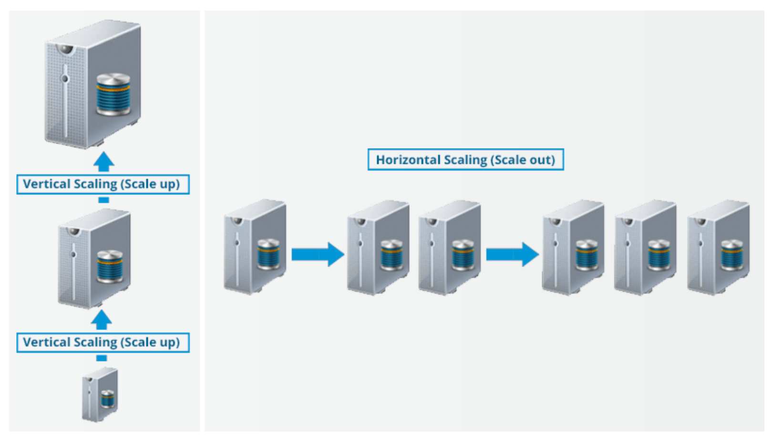
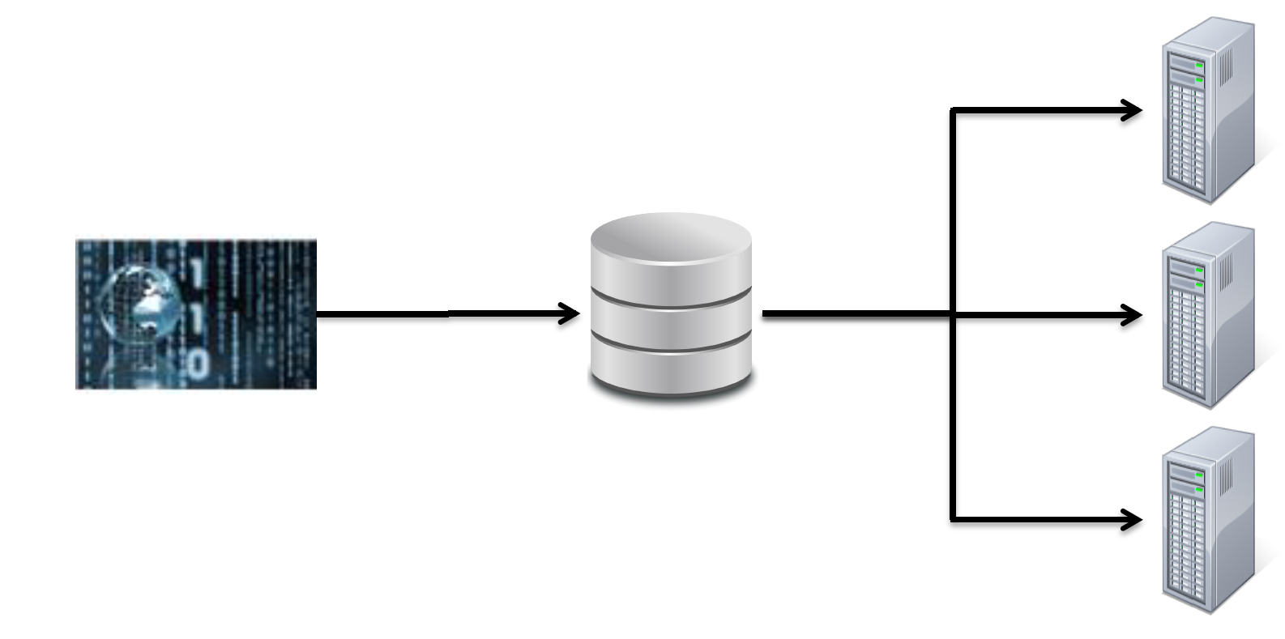
Why Big Data Systems?
You can’t keep on increasing the RAM or CPU of the machine.
Data bottleneck of tradition distributed computing systems:
– Typical disk data transfer rate: 75MB/sec
– Time taken to transfer 100GB of data to the processor: approx 22 minutes
– Actual time will be worse, since most servers have less than 100GB of RAM available

Slide 6
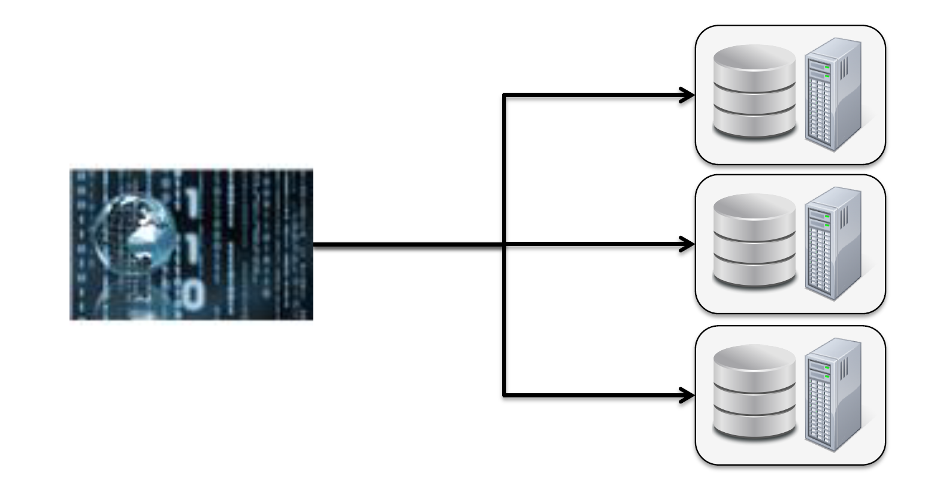
Hadoop cluster
A radical new approach to distributed computing
– Distribute data when the data is being stored
– Run computation where the data is stored

Slide 7
What is Hadoop?
A scalable fault-tolerant distributed systems for Big Data storage and processing
Core components (HDFS and MapReduce in V1, + Yarn in V2)
1. HDFS: Distributed and redundant file system optimized for storing Big Bata sets.
- When data is loaded into the system, it is split into blocks
- Each block is replicated (default replication factor = 3) and stored on different machines
2. MapReduce: Programming model for Big Data processing
- Many nodes work in parallel, each on their own part of the overall dataset
- If a node fails, the master will detect that failure and re-assign the work to a different node on the system

Slide 8
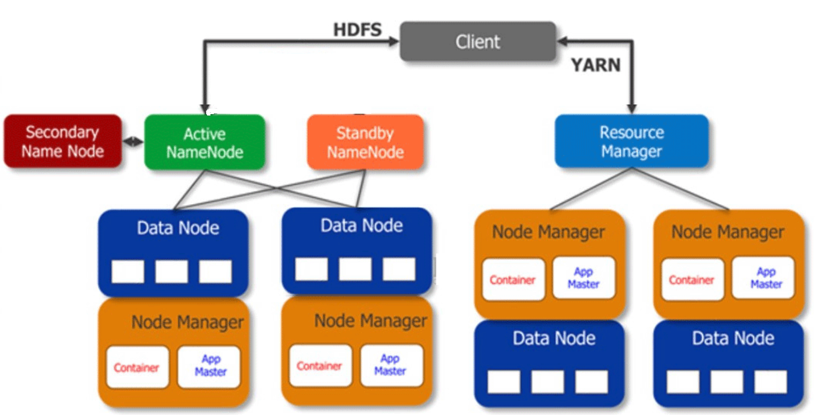
Hadoop: Very High Level Overview
Stores the meta data of data blocks
Masters
Tracks resources on the cluster and assigns jobs to Node Managers
Slaves
Stores the data blocks
Performs map-reduce jobs

Slide 9
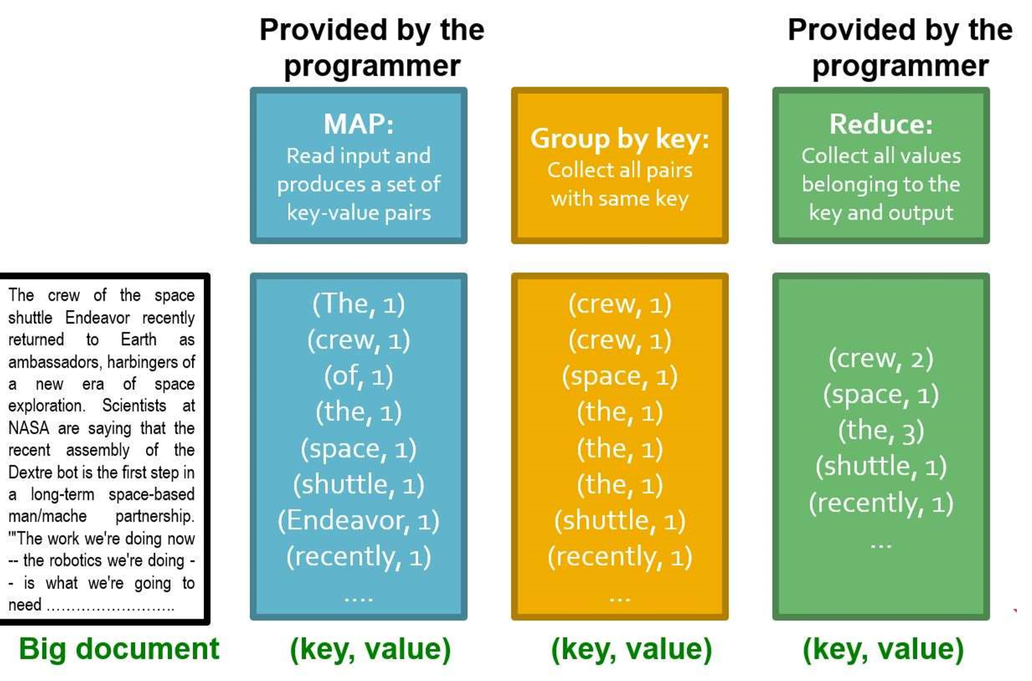
MapReduce Overview
Problem, compared with Spark: MapReduce cannot cache the intermediate data (such as outputs of the mappers) in memory

Slide 10
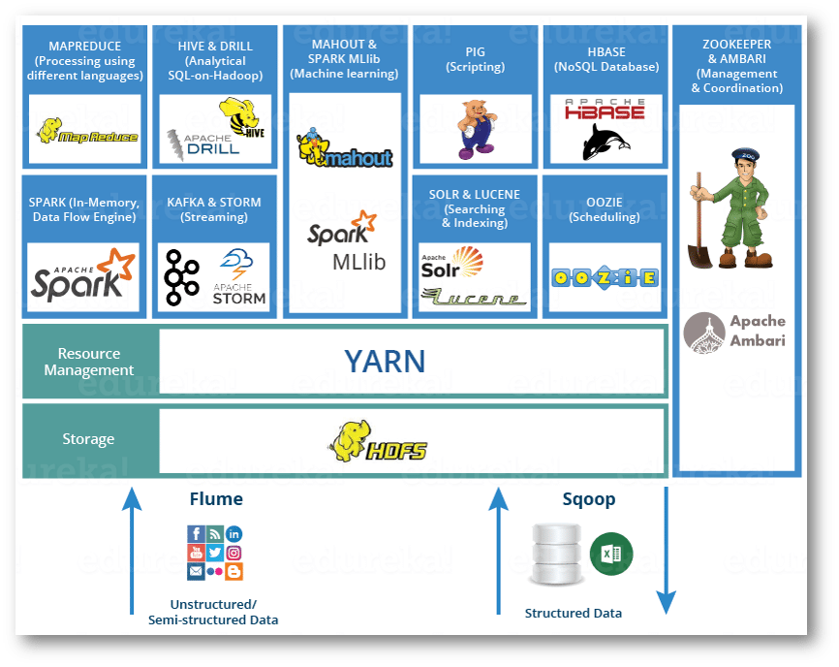
Hadoop Ecosystem

Slide 11
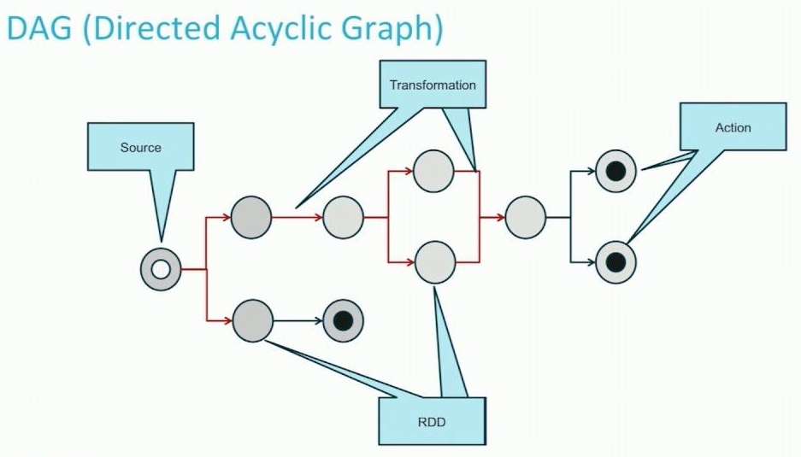
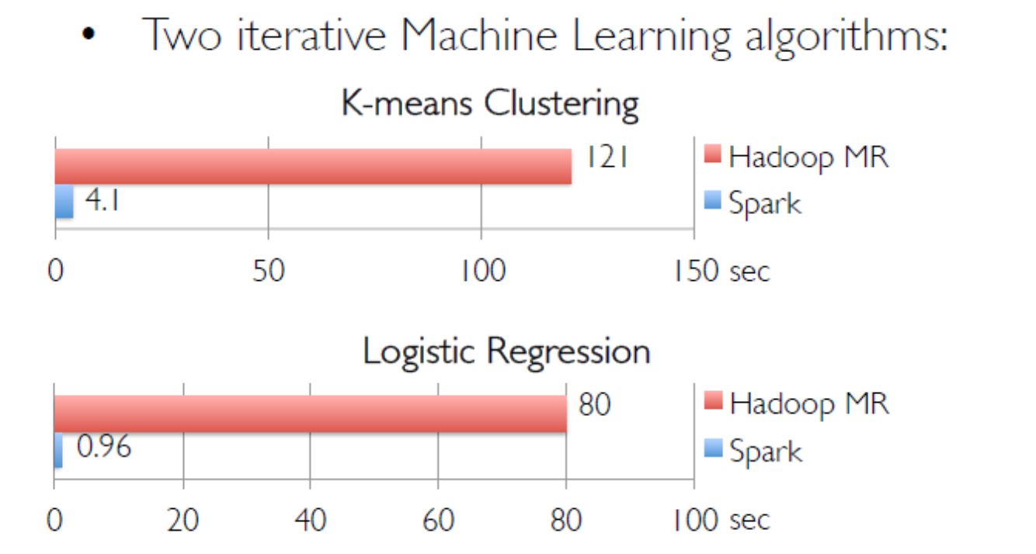
Spark
Keep data in memory
Stores data in RDDs rather than key-value pairs.

Slide 12
Spark ecosystem

Slide 13
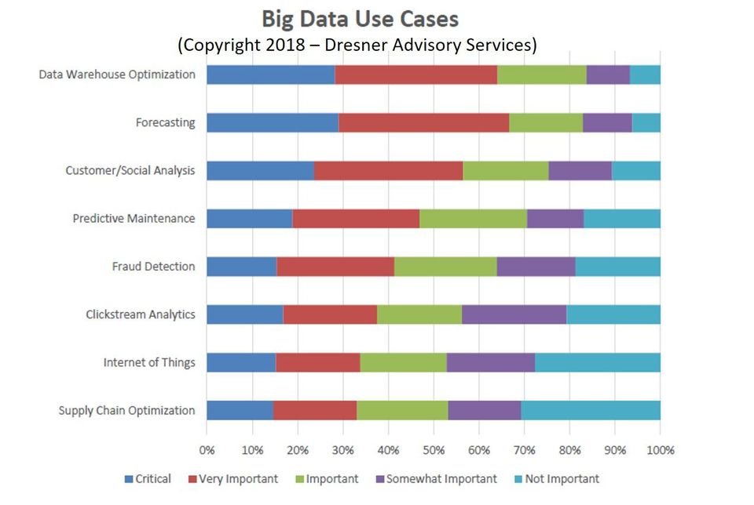
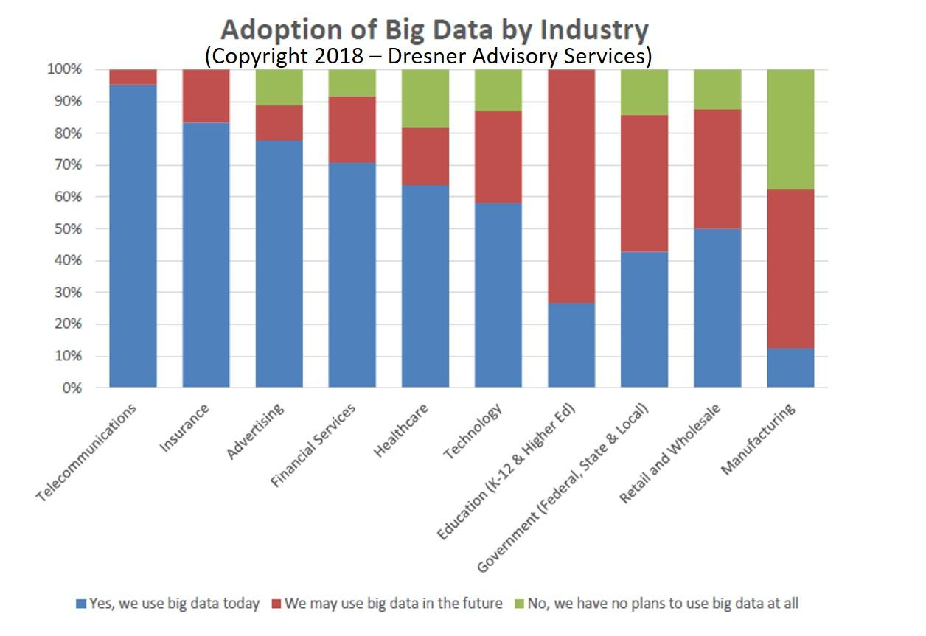
Big Data, Big Opportunities
Big Data adoption in enterprises soared from 17% in 2015 to 59% in 2018
Generate $5.3 billion in 2018
AWS S3, Spark SQL, Hive, and HDFS are the most popular big data access methods.
Apache Spark Mllib and Tensorflow are the most-adopted big data analytics and machine learning technologies in enterprises today.
https://www.forbes.com/sites/louiscolumbus/2018/12/23/big-data-analytics-adoption-soared-in-the-enterprise-in-2018/#2d7f6ac3332f

Slide 14
Opportunity for students
The average salary of the analytics jobs is around $94,167. Data Scientist has been named the best job in America for three years running, with a median base salary of $110,000 and 4,524 job openings

